Slide 1
Topic: Seasonal Anime
Jaron Zhou, Tony Zhong, Qinglu Du

Slide 2
Goal
To analyze the trends behind the popularity of seasonal anime of 2020
Winter, Spring, Summer
Entities
Animes (Jaron Zhou)
Character (Jaron Zhou)
Voice Actors (Jaron Zhou)
Directors (Tony Zhong)
Studios (Tony Zhong)
DirectedBy (Tony Zhong)
AnimatedBy (Tony Zhong)
Licensors (Qinglu Du)
Artists (Qinglu Du)
Composers (Qinglu Du)
SungBy (Qinglu Du)
ComposedBy (Qinglu Du)

Slide 3
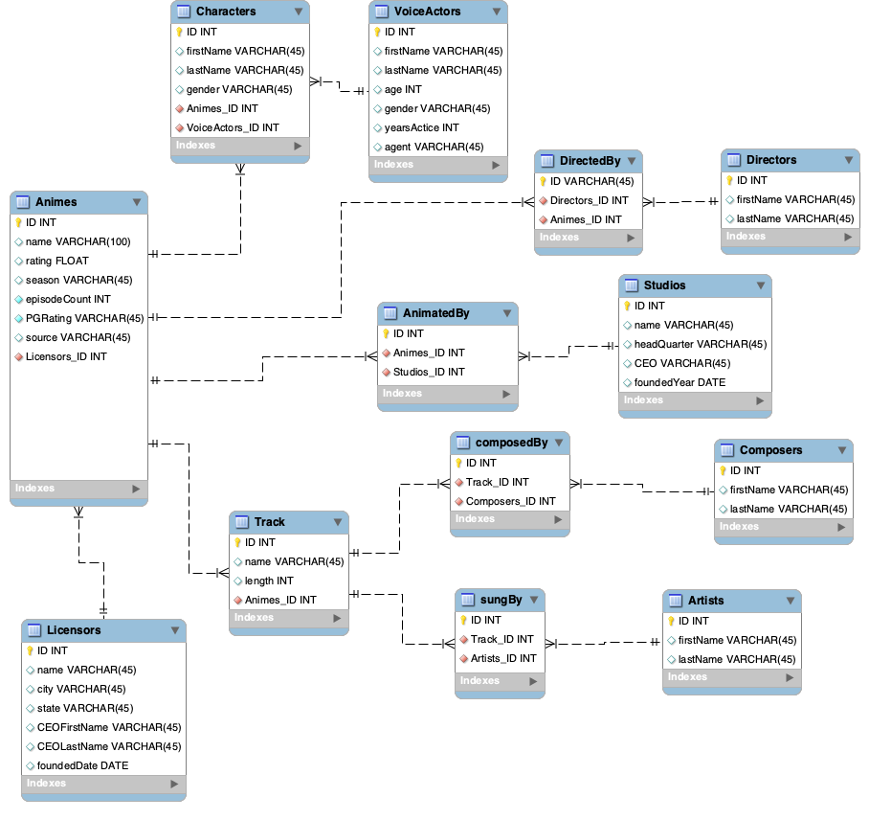
RDM

Slide 4
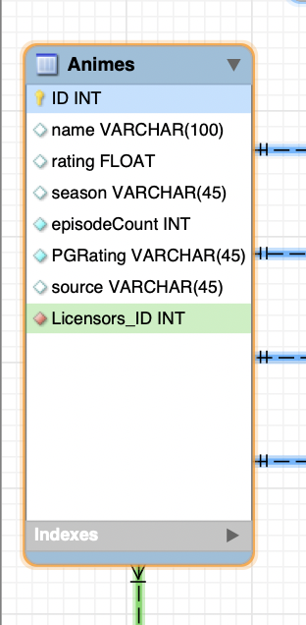
Animes
Characters
Track
DirectedBy
AnimatedBy
(PK) ID INT
name VARCHAR(100)
rating FLOAT
season VARCHAR(45)
episodeCount INT
PGRating VARCHAR(45)
source VARCHAR(45)
(FK) Licensors_ID INT
1:m
m:1
m:1
Licensors

Slide 5
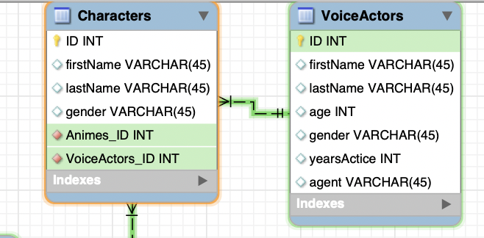
Characters m:1 VoiceActors
(PK) ID INT
firstName VARCHAR(45)
lastName VARCHAR(45)
age INT
gender VARCHAR(45)
yearsActive INT
agent VARCHAR(45)
(PK) ID INT
firstName VARCHAR(45)
lastName VARCHAR(45)
gender VARCHAR(45)
(FK) Animes_ID INT
(FK) VoiceActors_ID INT

Slide 6
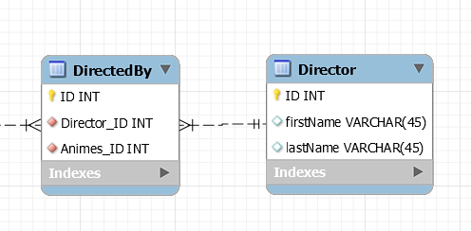
DirectedBy m:1 Directors
(PK) ID INT
(FK) Animes_ID INT
(FK) Directors_ID INT
(PK) ID INT
firstName VARCHAR(45)
lastName VARCHAR(45)
Notes:
Directors are in a many to many relationship with animes. DirectedBy is an associative entity

Slide 7
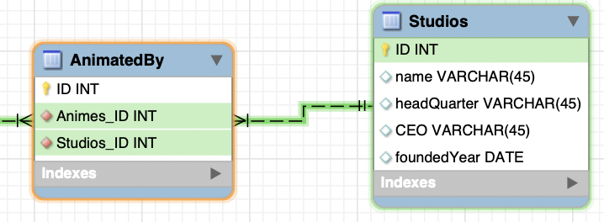
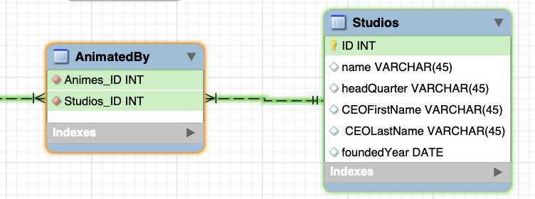
AnimatedBy m:1 Studios
(PK) ID INT
(FK) Animes_ID INT
(FK) Studios_ID INT
(PK) ID INT
name VARCHAR(45)
headQuarter VARCHAR(45)
CEOFirstName VARCHAR(45)
CEOLastName VARCHAR(45)
foundedYear DATE
Notes:
Studios is also in a many to many relationship with animes

Slide 8
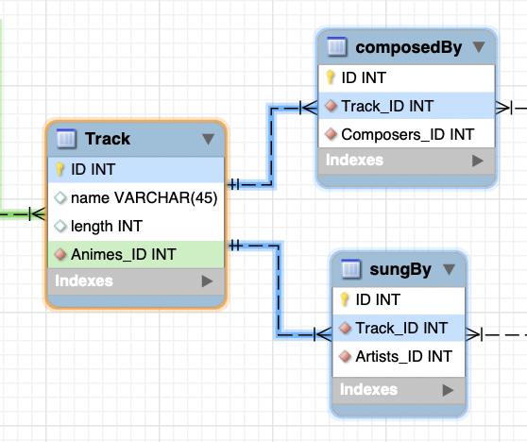
Track
composedBy
sungBy
(PK) ID INT
name VARCHAR(45)
length INT
(FK)Animes_ID INT
1:m
(PK) ID INT
(FK)Track_ID INT
(FK)Composers_ID INT
1:m
(PK) ID INT
(FK)Track_ID INT
(FK)Artists_ID INT

Slide 9
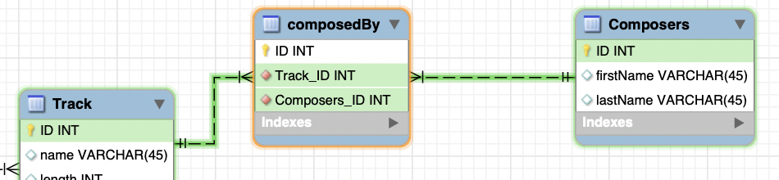
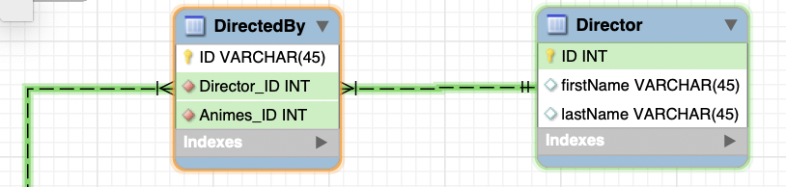
ComposedBy m:1 Composers
(PK) ID INT
(FK) Track_ID INT
(FK) Composers_ID INT
(PK) ID INT
firstName VARCHAR(45)
LastName VARCHAR(45)

Slide 10
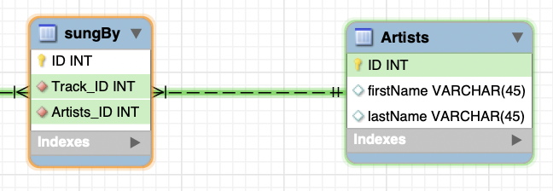
SungBy m:1 Artists
(PK) ID INT
(FK) Track_ID INT
(FK) Artists_ID INT
(PK) ID INT
firstName VARCHAR(45)
LastName VARCHAR(45)

Slide 11
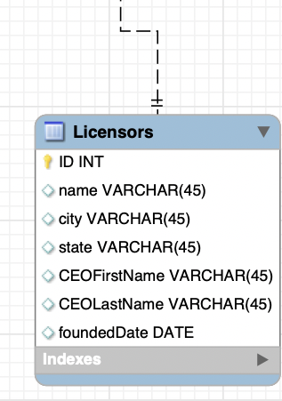
Licensors
(PK) ID INT
name VARCHAR(45)
city VARCHAR(45)
state VARCHAR(45)
CEOFirstName VARCHAR(45)
CEOLastName VARCHAR(45)
foundedDate DATE

Slide 12
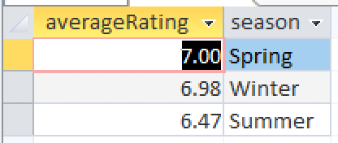
Query 1: (What is the average rating of each season)
SELECT Avg(Animes.rating) AS averageRating, Animes.season
FROM Animes
GROUP BY Animes.season
ORDER BY AVG(Animes.rating) DESC;

Slide 13
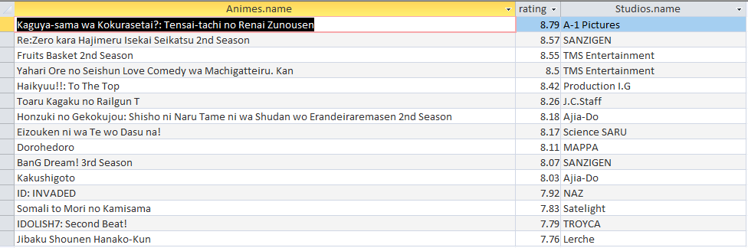
Query 2: (Which studios produced highest ratings)
SELECT TOP 15 Animes.name, Animes.rating, Studios.name
FROM Animes INNER JOIN (Studios INNER JOIN AnimatedBy ON Studios.ID = AnimatedBy.Studios_ID)
ON Animes.ID = AnimatedBy.Animes_ID
GROUP BY Studios.name, Animes.rating, Animes.name
ORDER BY rating DESC;

Slide 14
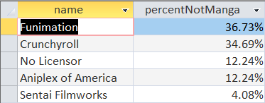
Query 3: (What is percent of non-manga animes licensed by each licensor)
SELECT Licensors.name, COUNT(source)/(SELECT COUNT(source) FROM Animes WHERE source<>’Manga’) AS nonMangaPercent
FROM Licensors INNER JOIN Animes ON Licensors.ID = Animes.Licensor_ID
WHERE (Animes.source)<>'Manga'
GROUP BY Licensors.name
ORDER BY Count(Animes.source) DESC

Slide 15

Query 4: (How many characters were voiced by the opposite gender)
SELECT COUNT(Characters.gender) AS queryResults
FROM (
SELECT VoiceActors.firstName & " " & VoiceActors.lastName AS voiceActorName,
Characters.firstName & " " & Characters.lastName AS characterName, Characters.gender, VoiceActors.gender
FROM VoiceActors INNER JOIN Characters ON Characters.voiceActors_ID = VoiceActors.ID
WHERE Characters.gender <> VoiceActors.gender
GROUP BY VoiceActors.firstName & " " & VoiceActors.lastName, Characters.gender, VoiceActors.gender, VoiceActors.gender, Characters.firstName & " " & Characters.lastName)
UNION
SELECT COUNT(*) as characters
FROM Characters;
Notes:
For Query 4, we were surprised to know that some characters are voiced by the VA of an opposite gender. So, we did a query to find out exactly how many characters are voiced by a VA of an opposite gender. I did a UNION between two different queries to show both the total amount of characters and the amount of characters that we're interested in. To get the amount of characters voiced by the opposite gender, I chose to write a subquery in the FROM clause where the the characters' gender is not equal to the voice actors' gender, and then count the amount of entries in the table with the COUNT() function in SELECT.

Slide 16
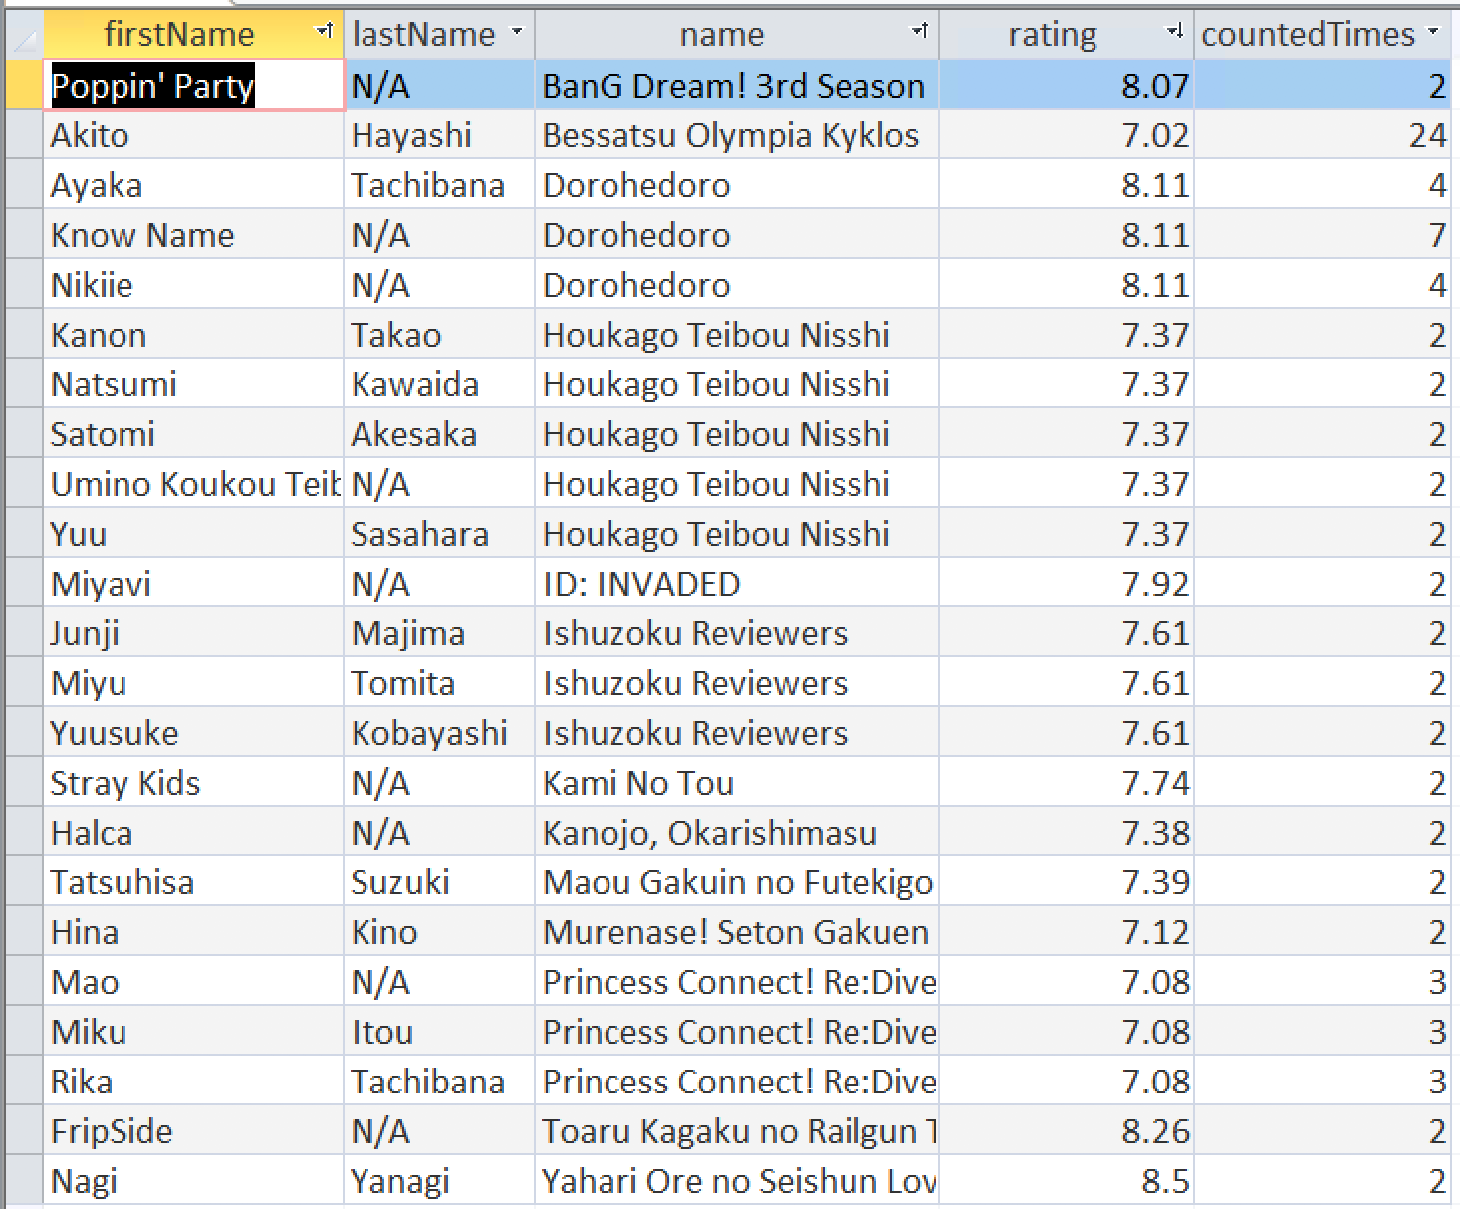
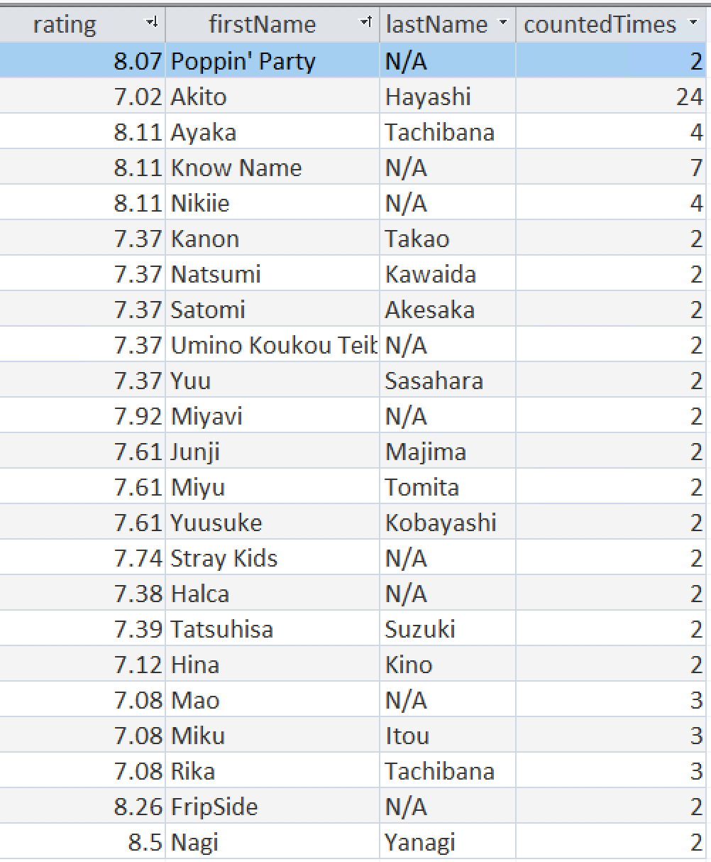
Query 5: (Which artists participated in more top rated anime)
SELECT DISTINCT Artists.firstName, Artists.lastName, Animes.name, Animes.rating, COUNT(Artists.firstName) as countedTimes
FROM (Animes INNER JOIN Track ON Animes.[ID] = Track.[Animes_ID]) INNER JOIN (Artists INNER JOIN SungBy ON Artists.[ID] = SungBy.[Artists_ID]) ON Track.[ID] = SungBy.[Track_ID]
WHERE EXISTS
(SELECT Artists.firstName, Artists.lastName, COUNT(Artists.firstName) as countedTimes
FROM (Animes INNER JOIN Track ON Animes.[ID] = Track.[Animes_ID]) INNER JOIN (Artists INNER JOIN SungBy ON Artists.[ID] = SungBy.[Artists_ID]) ON Track.[ID] = SungBy.[Track_ID]
WHERE Animes.rating > 7
GROUP BY Artists.firstName, Artists.lastName
HAVING COUNT(Artists.firstName) > 1)
GROUP BY Animes.rating, Animes.name, Artists.firstName, Artists.lastName
HAVING COUNT(Artists.firstName) > 1
AND Animes.rating > 7
ORDER BY rating DESC;
Notes:
Ratings > 7

Slide 17
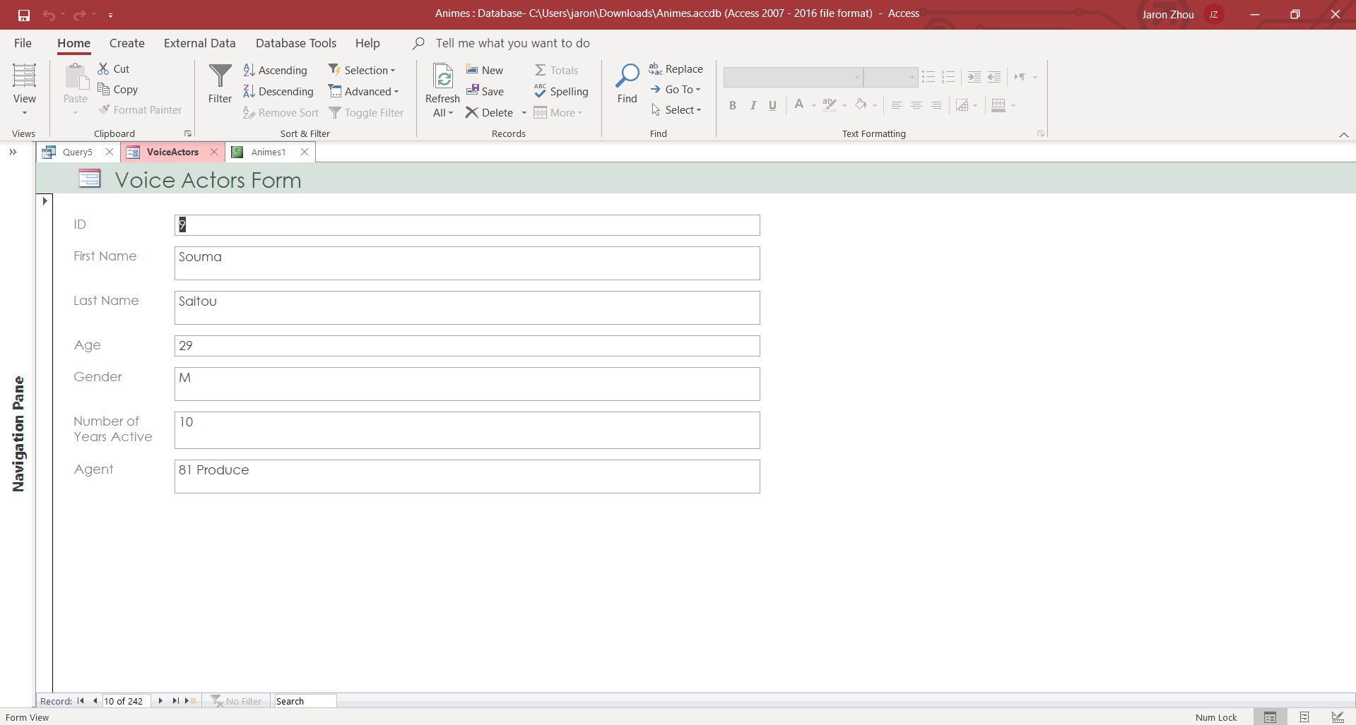
Voice Actors Simple Form

Slide 18
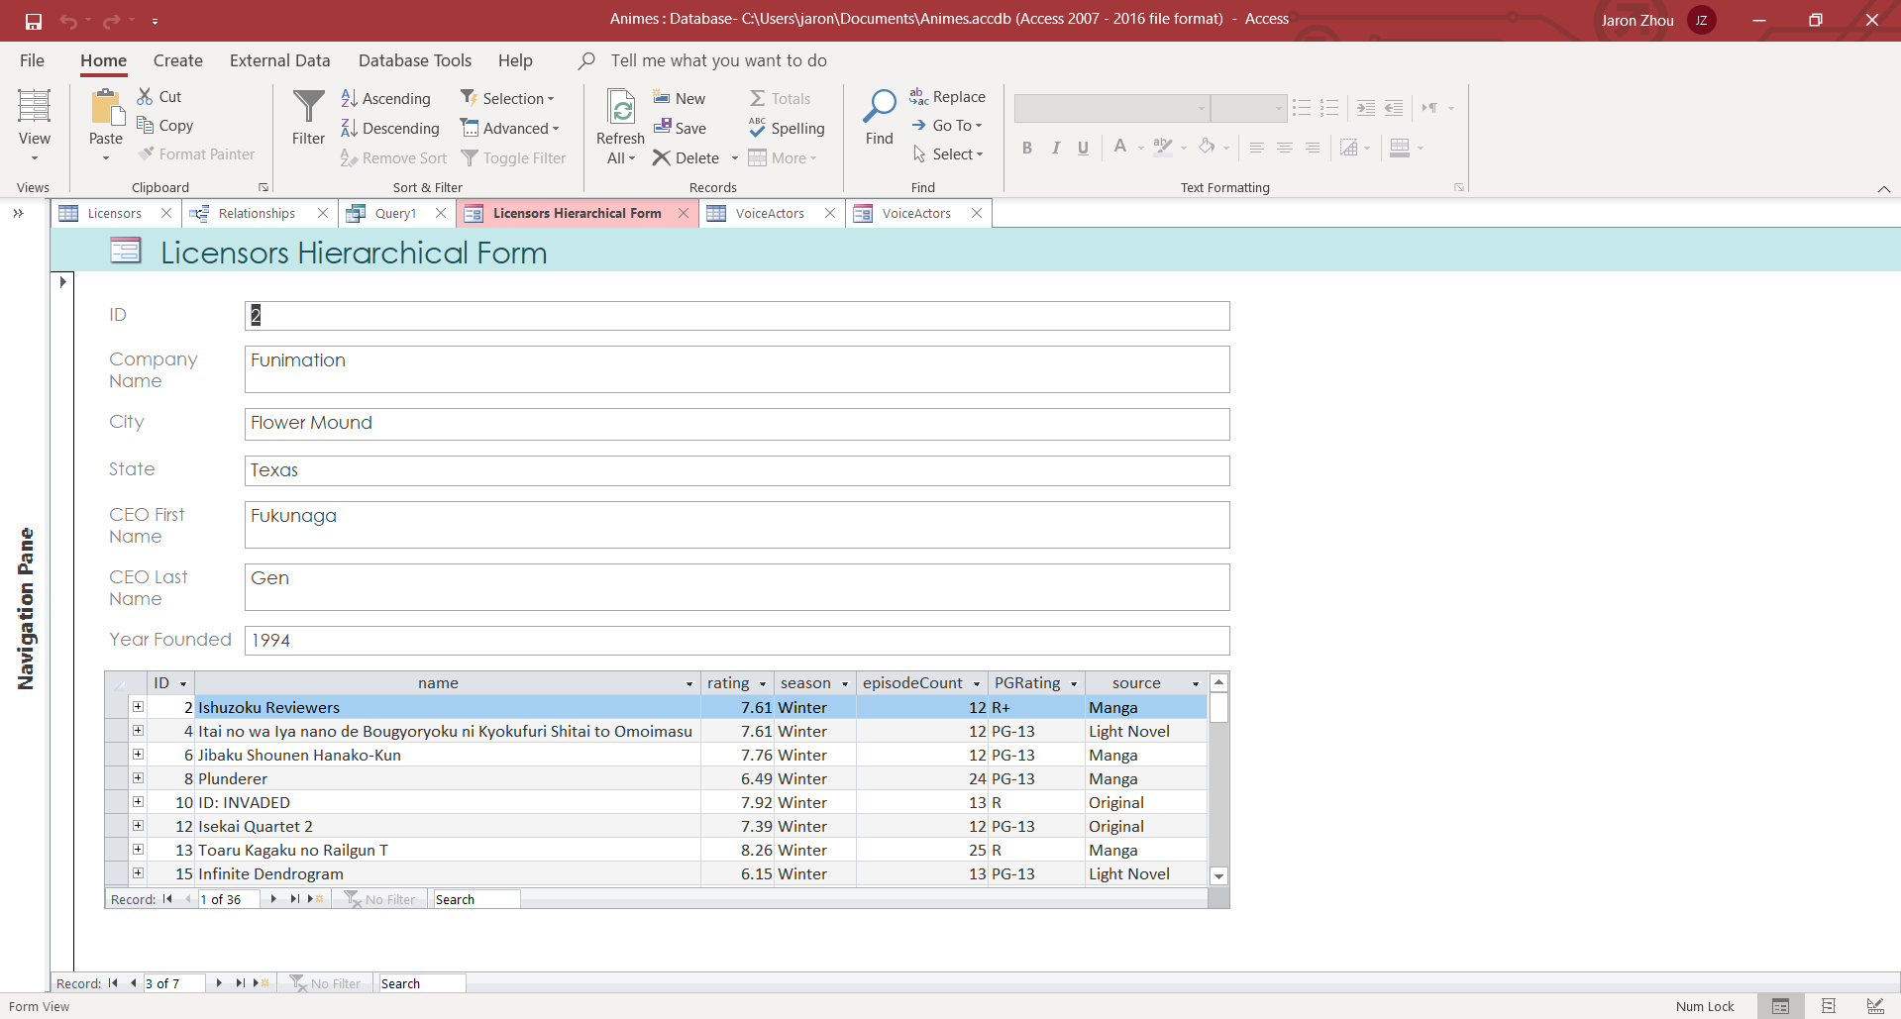
Licensors Hierarchical Form

Slide 19
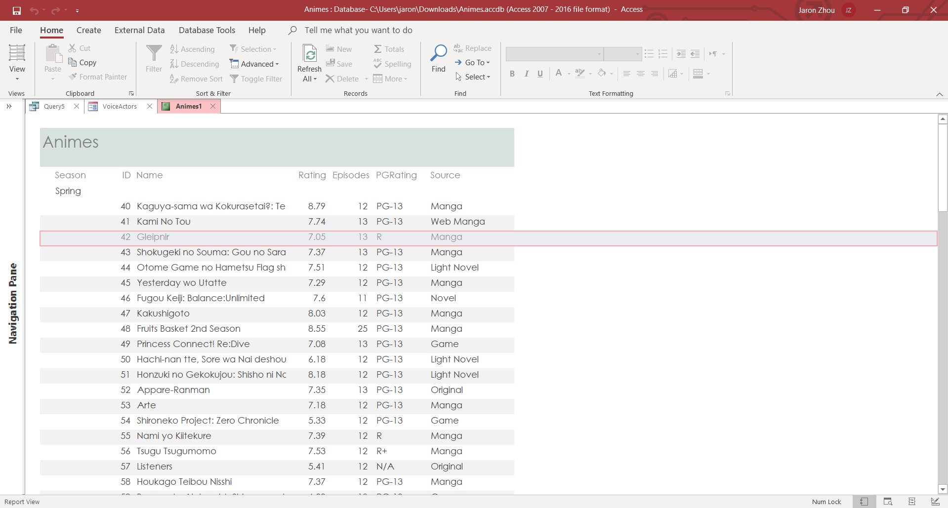
Animes Report

Slide 20
References
MyAnimeList.com
Animesongs.org
Wikipedia.org
IMDB.com

